Slide 1
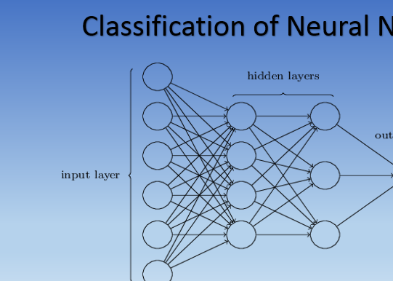
What we are trying to solve?
Attempted a Text-to-Image Synthesis
How we have Solved?
Used a GAN and VAE Architectures
Total Images 40945 of Flowers
Trained about 29390 images with pretrained text labels
Tested on 5775 images and validated on 5780 images
Type of Losses implemented BCE_loss, MSE_loss, L1_loss
How well it worked?
Ran for 10 epochs with generator loss and discriminator loss
However, planned to perform on more epochs
Propose to well fine tune the hyperperameters and changed the n/w architecture to minimize loss and increase the accuracy

Slide 2
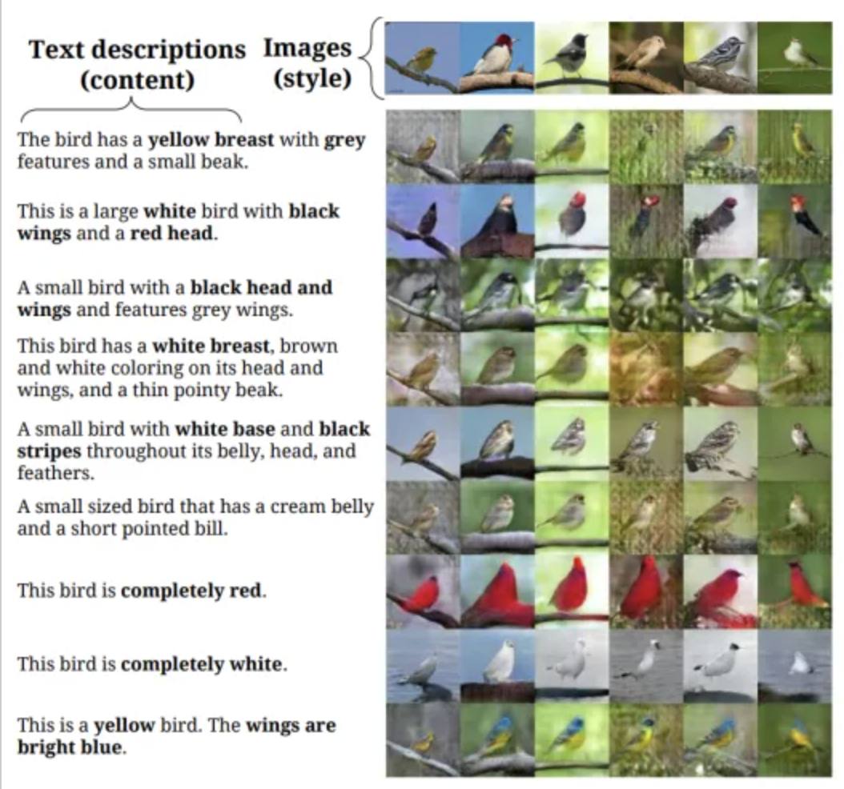
Background
With Introduction of GANS Image Synthesis From text a recently evolving field
But faces challenges as follows: -
generation of high-resolution images with multiple objects
developing suitable and reliable evaluation metrics
What have others done?
Used Conditional GANS, Styled GANS to satisfy the purpose
Worked on COCO and CUB-200 Birds Dataset to achieve synthesis
Why is it interesting?
Aims to learn mapping from semantic text space to complex RGB image space
Useful for generating photo-realistic images from text
Easy solution for photo-editing and computer-aided design softwares

Slide 3
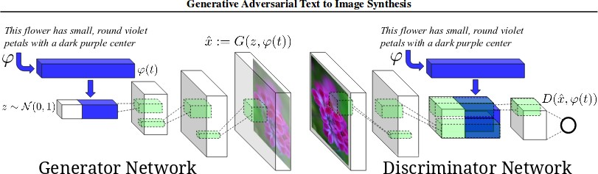
Methods
We propose to follow K-nearest neighbor approach in the highlevel feature space in the training of GAN
GAN uses K-nearest neighbor (K-NN) selective feature matching during the adversarial training
Used unsupervised output embeddings that learned from Wikipedia and improved with finegrained text to achieve compelling result.
These embedding are generated by simply interpolating between embeddings of training set captions.
Critically, these interpolated text embeddings need not correspond to any actual human-written text, so there is no additional labeling cost
Satisfying D on interpolated text embeddings helps G to learn which fills gaps on the data manifold in between training points.

